Slide 1
Employee Data Analysis using Excel
STUDENT NAME:N.PRAVEENA
REGISTER NO:122203089&(unm14512022h27)
DEPARTMENT:B.COM(CORPORATE SECRETARYSHIP)
COLLEGE: MAHALASHMI WOMEN'S COLLEGE OF ARTS AND SCIENCE

Slide 2
PROJECT TITLE
Employee Performance Analysis using Excel

Slide 3


AGENDA
Problem Statement
Project Overview
End Users
Our Solution and Proposition
Dataset Description
Modelling Approach
Results and Discussion
Conclusion
3/21/2024 Annual Review

Slide 4

PROBLEM STATEMENT
To develop a comprehensive system for evaluating and analyzing employee performance within the organization to enhance productivity, identify areas for improvement, and align individual goals with organizational objectives.

Slide 5

PROJECT OVERVIEW
1.Evaluate employee performance to identify strengths and areas for improvement. 2.Align performance with organizational goals and
strategies. 3.Provide actionable insights for professional development and performance enhancement.
.

Slide 6

WHO ARE THE END USERS?
1.IT COMPANIES
2.BANKS
3.INDUSTRIES
4.HUMAN RESOURCE DEPARTMENT

Slide 7

OUR SOLUTION AND ITS VALUE PROPOSITION
1.Conditional Formatting-Missing
2.Filtering-Remove
3.Formula used to identify performance level
4.Pivot-Summarizing
5.Graph-Data Visualisation

Slide 8
Dataset Description
1.Employee data downloaded from edunet dashboard
2.Totally 26 features were available In that 12 Were Considered

Slide 9

THE "WOW" IN OUR SOLUTION
Performance level=IFS(Z8>=5,"EXCELLENT",Z8>-4,"HIGH",Z8>=3,"MED", TRUE, "LOW")
3/21/2024 Annual Review
9

Slide 10
MODELLING
1.Data Collection Downloaded the data from edunet student's dashboard. 2.Feature Collection: Highlighted data which is required using the fill option. 3.Data Cleaning: Identified the missing values using conditional formatting. Removed/Filtered the missing data using filter-filter by colour. 4.Performance level: Performance Analysis is based on Department type is filtered by gender (Male employees)
10

Slide 11
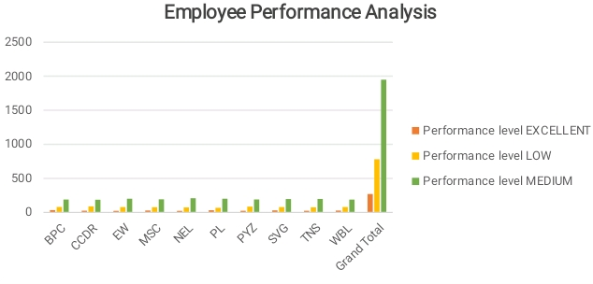
RESULTS
11

Slide 12
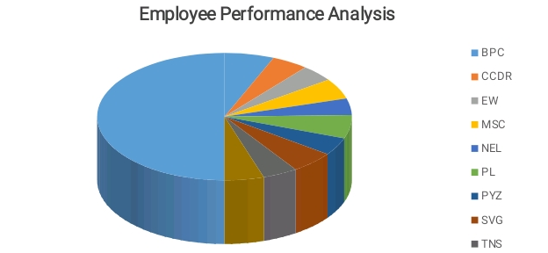
RESULTS

Slide 13
conclusion
Performance analysis can help companies consider metrics and goals such as income from different product lines, financial liabilities, return on sales, and more. It can also help companies review and adjust costs, upgrade facilities and equipment, and evaluate staff skills and performance.

